Slide 1
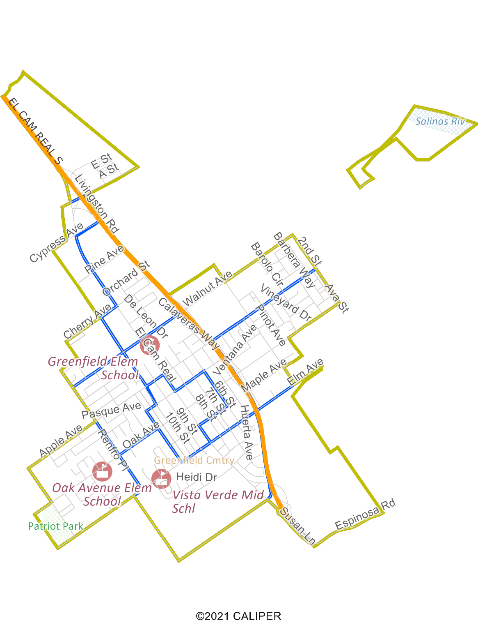
City of Greenfield Transition to District Elections
Dr. Daniel Phillips, Consultant
National Demographics Corporation

Slide 2
Transition Process
Step | Description
Three pre-draft hearings: Jan. 31, Feb. 3 & 8 | Held prior to the release of draft plans. Purpose is to educate on the process and to solicit input on the neighborhoods and communities of interest in the City.
Deadline for draft plans: Feb. 13 | Deadline for the public to submit draft plans for consideration at the post-draft hearings.
Release draft plans: Feb. 16 | Draft plans posted to the City website. All draft plans to be considered must be posted at least 7 days prior to the first post-draft hearing.
Two post-draft hearings: Feb. 23 & Mar. 16 | Purpose is to present, discuss, and, if necessary, revise the draft plans, and to discuss the election sequence.
Plan adoption: Mar. 21 & Apr. 12 | Plan adopted via ordinance. First and second readings. Final plan must be posted at least 7 days prior to adoption.

Slide 3
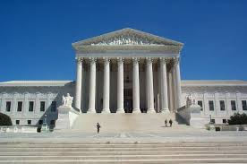
Rules and Goals for Drawing Districts
1. Federal Laws
2. California Criteria for Cities
3. Other Traditional Districting Principles
Equal Population
Federal Voting Rights Act
No Racial Gerrymandering
Geographically contiguous
Undivided neighborhoods and “communities of interest” (Socio-economic geographic areas that should be kept together)
Easily identifiable boundaries
Compact (Do not bypass one group of people to get to a more distant group of people)
Prohibited:
“Shall not favor or discriminate against a political party.”
Respect voters’ choices / continuity in office
Future population growth

Slide 4
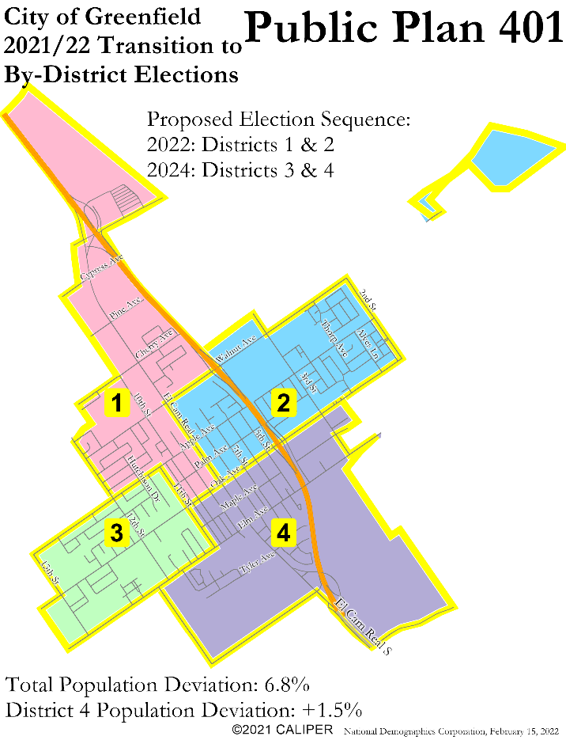
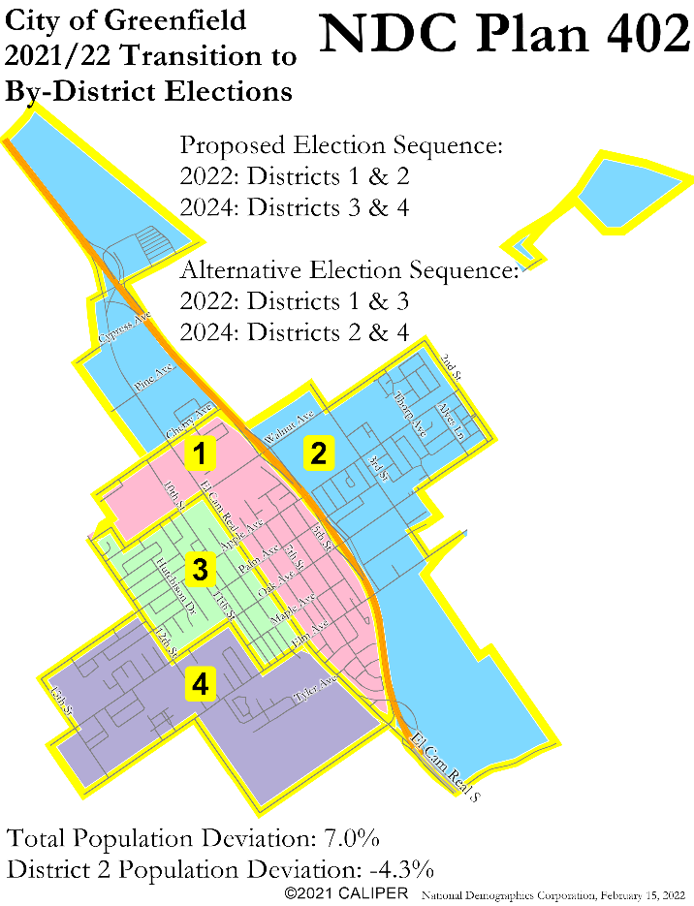
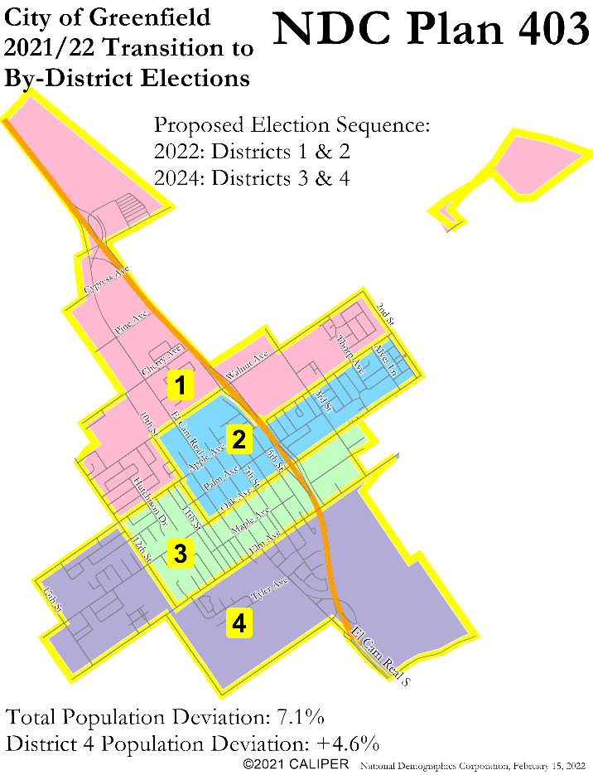
Four District Draft Plans
Downtown split between Districts 1, 2 & 4
High future growth area in District 4
Boundaries along El Cam Real & Oak
Downtown split between Districts 1 & 3
High future growth area in District 2
Boundaries along El Cam Real & Hwy 101
Downtown split between Districts 2 & 3
High future growth area in District 4
Boundaries along Apple, Oak & Elm

Slide 5
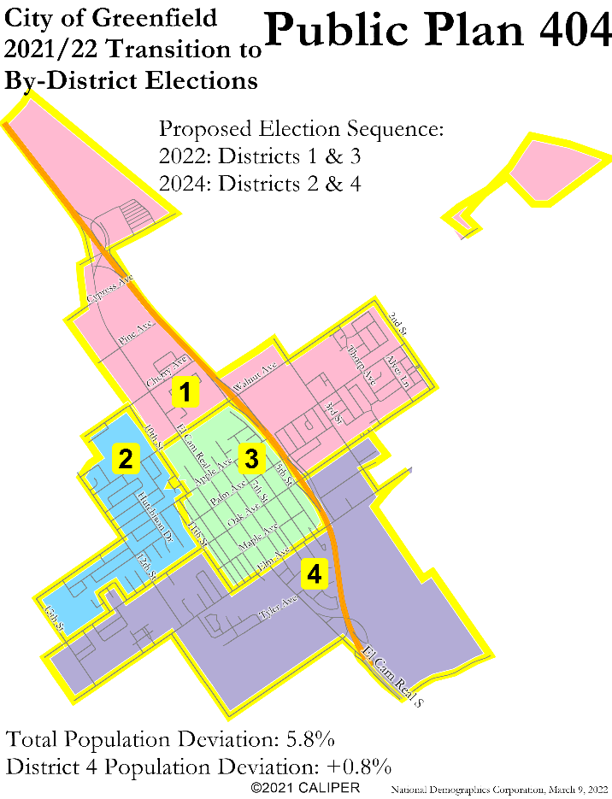
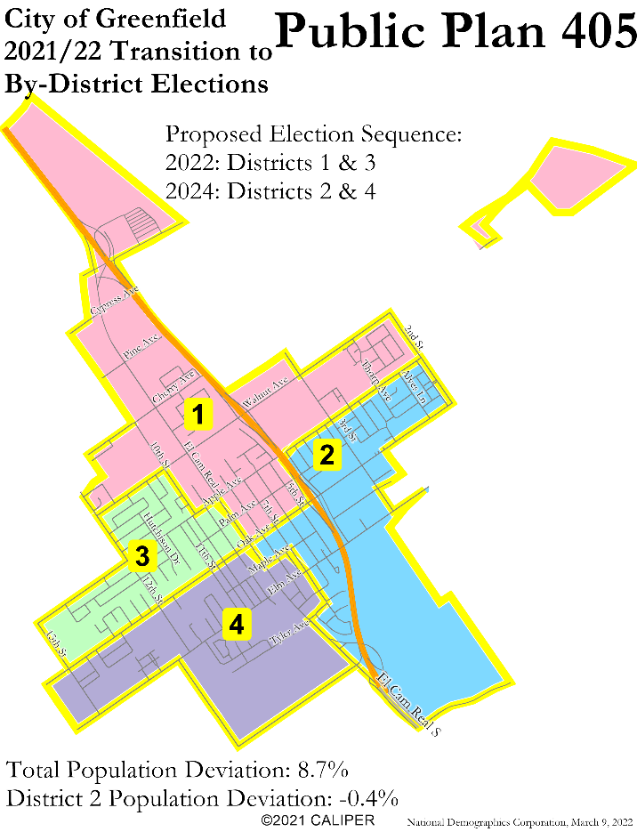

Four District Draft Plans
Downtown contained in District 3
High future growth area in District 4
Boundaries along Walnut, Elm & Hwy 101
Downtown split between all four districts
High future growth area in District 2
Boundaries along Apple, Oak & ECR
Downtown split between all four districts
High future growth area in District 2
Boundaries along Apple, Oak & ECR

Slide 6
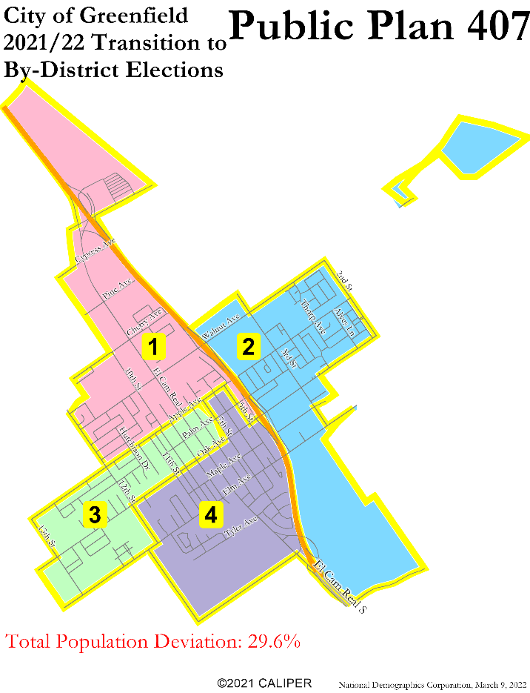
Four District Draft Plans
Not population balanced

Slide 7
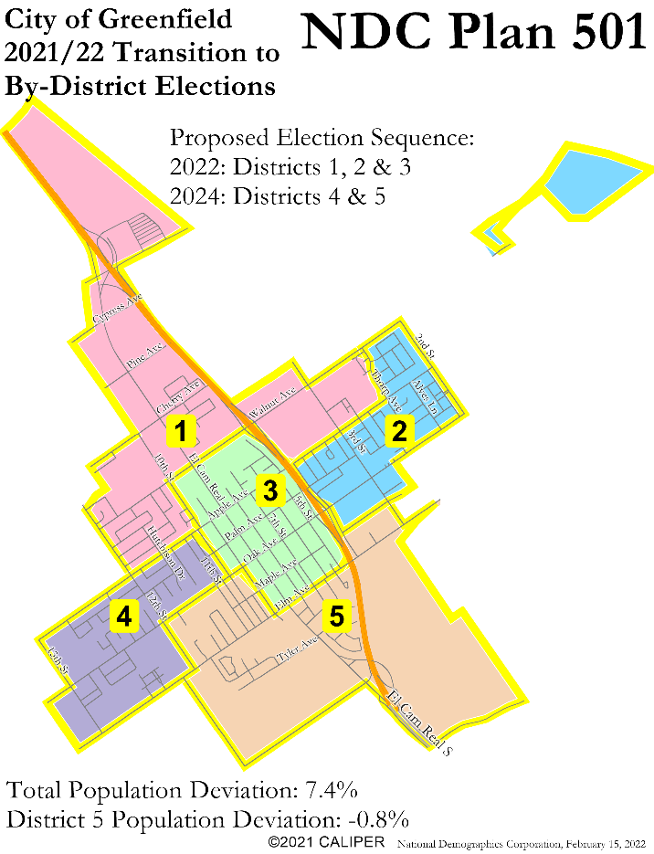
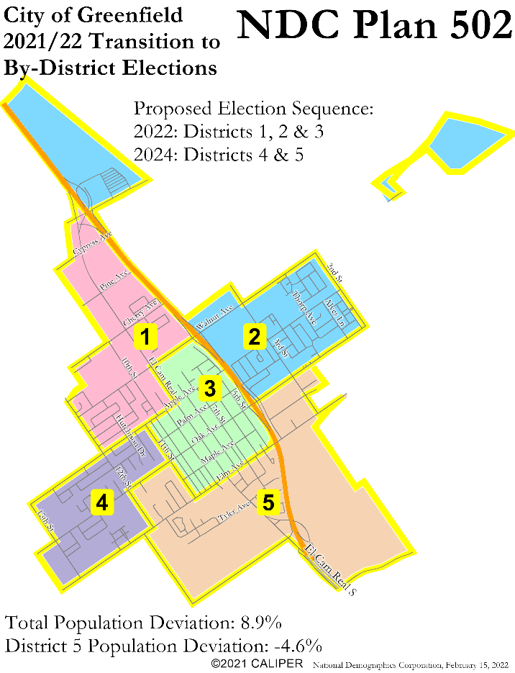
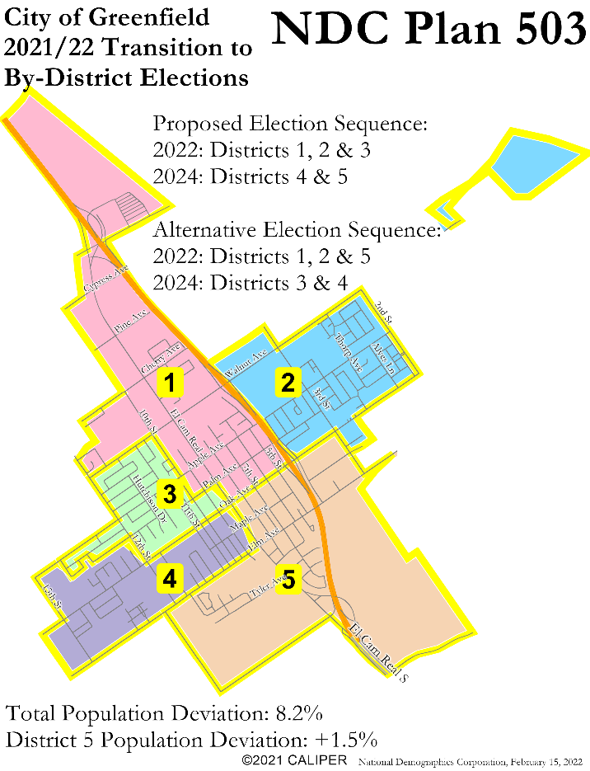
Five District Draft Plans
Downtown contained in District 3
High future growth area in District 5
Boundaries along 10th & Hwy 101
Downtown contained in District 3
High future growth area in District 5
Boundaries along 11th & Hwy 101
Downtown split between four districts
High future growth area in District 5
Boundaries along El Cam Real & Oak

Slide 8
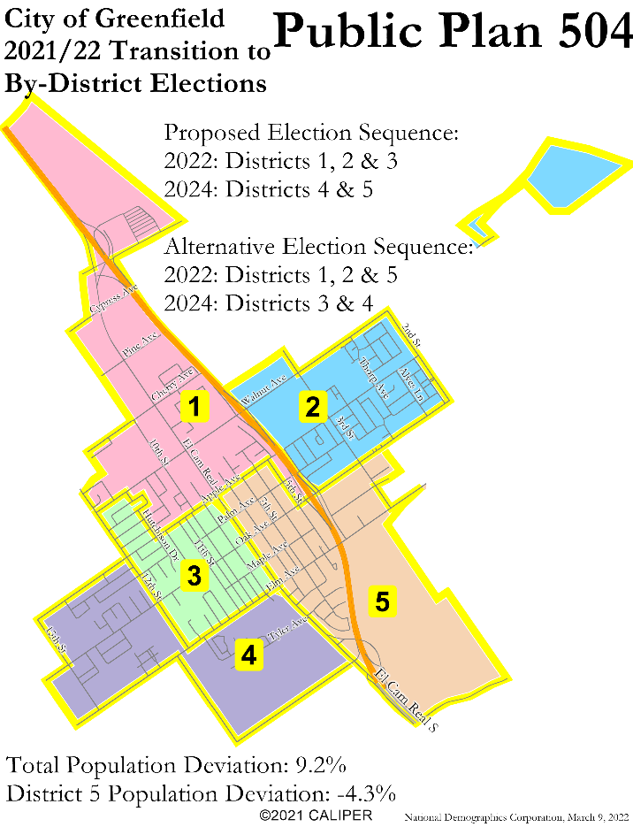
Five District Draft Plans
Downtown split between Districts 1, 3 & 5
High future growth area in District 5
Boundaries along Apple, Elm & ECR

Slide 9
Election Sequence Options
District | Public Plan 401 | NDC Plan 402 | NDC Plan 403 | Public Plan 404 | Public Plan 405 | Public Plan 406
1 | 2022 (vacant) | 2022 or 2024 (vacant) | 2022 (Tipton & Untalon) | 2022 (Tipton & Untalon) | 2022 (Tipton & Untalon) | 2022 (Tipton & Untalon)
2 | 2022 (Tipton & Untalon) | 2022 or 2024? (three incumbents) | 2022 (vacant) | 2022 or 2024 (vacant) | 2024 (Martinez) | 2024 (Martinez)
3 | 2024 (White) | 2022 or 2024 (vacant) | 2024 (Martinez) | 2022 or 2024 (vacant) | 2022 (vacant) | 2022 (vacant)
4 | 2024 (Martinez) | 2024 (White) | 2024 (White) | 2024 (Martinez & White) | 2024 (White) | 2024 (White)
(There must be two districts up in 2022 and two in 2024)

Slide 10
Election Sequence Options
District | NDC Plan 501 | NDC Plan 502 | NDC Plan 503 | Public Plan 504
1 | 2022 (Untalon) | 2022 (vacant) | 2022 or 2024 (vacant) | 2022 or 2024 (vacant)
2 | 2022 (Tipton) | 2022 (Tipton & Untalon) | 2022 (Tipton & Untalon) | 2022 (Tipton & Untalon)
3 | 2022 (Walker) | 2022 (Walker) | 2022 or 2024 (vacant) | 2022 or 2024 (vacant)
4 | 2024 (White) | 2024 (White) | 2024 (White) | 2024 (White)
5 | 2024 (Martinez) | 2024 (Martinez) | 2022 or 2024? (Walker & Martinez) | 2022 or 2024? (Walker & Martinez)
(There must be three districts up in 2022 and two in 2024)

Slide 11
Public Hearing & Discussion
Questions about the proposed draft plans?
Which number of districts is best for the city?
Which draft plan do you prefer?
Please refer to the Interactive Review Map for a detailed look at each plan

