Slide 1
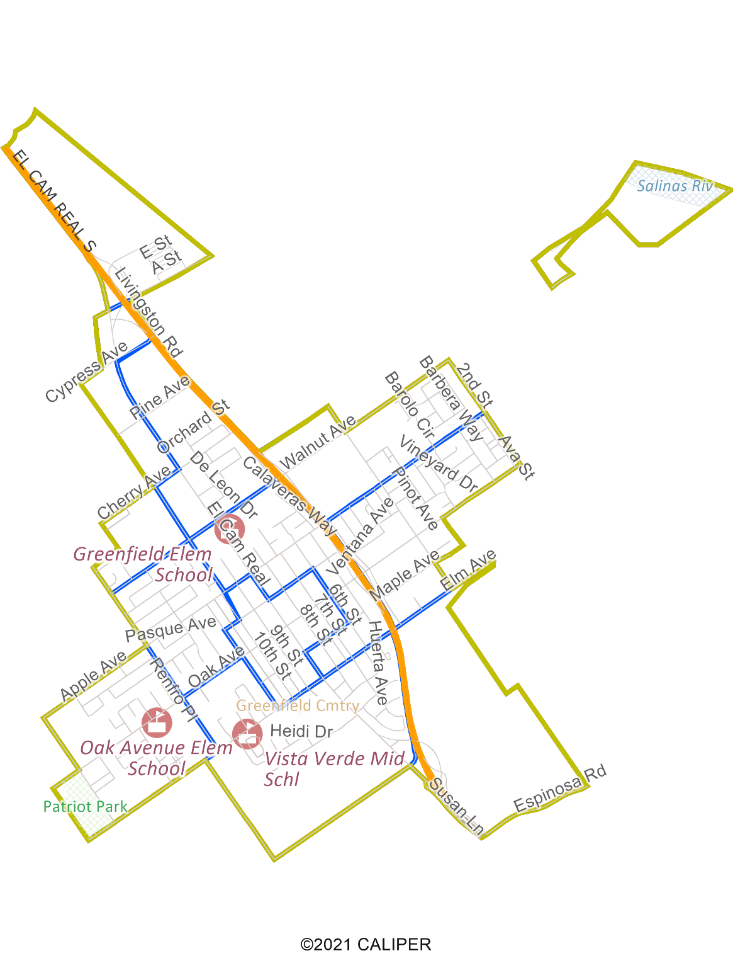
City of Greenfield Transition to District Elections
Dr. Daniel Phillips, Consultant
National Demographics Corporation

Slide 2
Election Systems
“At Large”
“From District”
“By District”
The California Voting Rights Act was written to specifically encourage by-district elections

Slide 3
California Voting Rights Act (CVRA)
Under the Federal Voting Rights Act (passed in 1965), a jurisdiction must fail 4 factual tests before it is in violation of the law.
The California VRA makes it significantly easier for plaintiffs to force jurisdictions into “by-district” election systems by eliminating two of the US Supreme Court Gingles tests:
Can the protected class constitute the majority of a district?
Does the protected class vote as a bloc?
Do the voters who are not in the protected class vote in a bloc to defeat the preferred candidates of the protected class?
Do the “totality of circumstances” indicate race is a factor in elections?
Liability is now determined only by the presence of racially polarized voting

Slide 4
CVRA Impact
Switched (or in the process of switching) as a result of CVRA:
At least 240 school districts
34 Community College Districts
154 cities
1 County Board of Supervisors
35 water and other special districts.
Cases So Far:
Palmdale, Santa Clara and Santa Monica went to trial on the merits. Palmdale and Santa Clara lost. Santa Monica is awaiting a decision.
Modesto and Palmdale each spent about $1.8 million on their defense (in addition to the attorney fee awards in those cases).
Santa Monica has spent an estimated $7 million so far. Plaintiffs in Santa Monica requested $22 million in legal fees after the original trial.
Key settlements:
Palmdale: $4.7 million
Modesto: $3 million
Highland: $1.3 million
Anaheim: $1.1 million
Whittier: $1 million
Santa Barbara: $600,000
Tulare Hospital: $500,000
Camarillo: $233,000
Compton Unified: $200,000
Madera Unified: about $170,000
Hanford Joint Union Schools: $118,000
Merced City: $42,000
An estimated $16 million in total settlements and court awards so far.

Slide 5
Transition Process
Step | Description
Two pre-draft hearings: Jan. 31 & Feb. 3 | Held prior to the release of draft plans. Purpose is to educate on the process and to solicit input on the neighborhoods and communities of interest in the City.
Release draft plans: Feb. 10 | Draft plans posted to the City website. All draft plans to be considered must be posted at least 7 days prior to the first post-draft hearing.
Two post-draft hearings: Feb. 17 & 23 | Purpose is to present, discuss, and, if necessary, revise the draft plans, and to discuss the election sequence.
Plan adoption: Mar. 21 & Apr. 12 | Plan adopted via ordinance. First and second readings. Final plan must be posted at least 7 days prior to adoption.

Slide 6
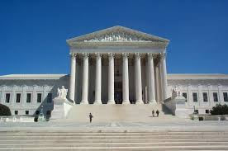
Rules and Goals for Drawing Districts
1. Federal Laws
2. California Criteria for Cities
3. Other Traditional Districting Principles
Equal Population
Federal Voting Rights Act
No Racial Gerrymandering
Geographically contiguous
Undivided neighborhoods and “communities of interest” (Socio-economic geographic areas that should be kept together)
Easily identifiable boundaries
Compact (Do not bypass one group of people to get to a more distant group of people)
Prohibited:
“Shall not favor or discriminate against a political party.”
Respect voters’ choices / continuity in office
Future population growth

Slide 7
Demographic Summary
All data presented are the official and most current data available.
If the city is divided into 4 districts, each must contain about 4,750 people.
If the city is divided into 5 districts, each must contain about 3,800 people.

Slide 8
Demographic Summary

Slide 9
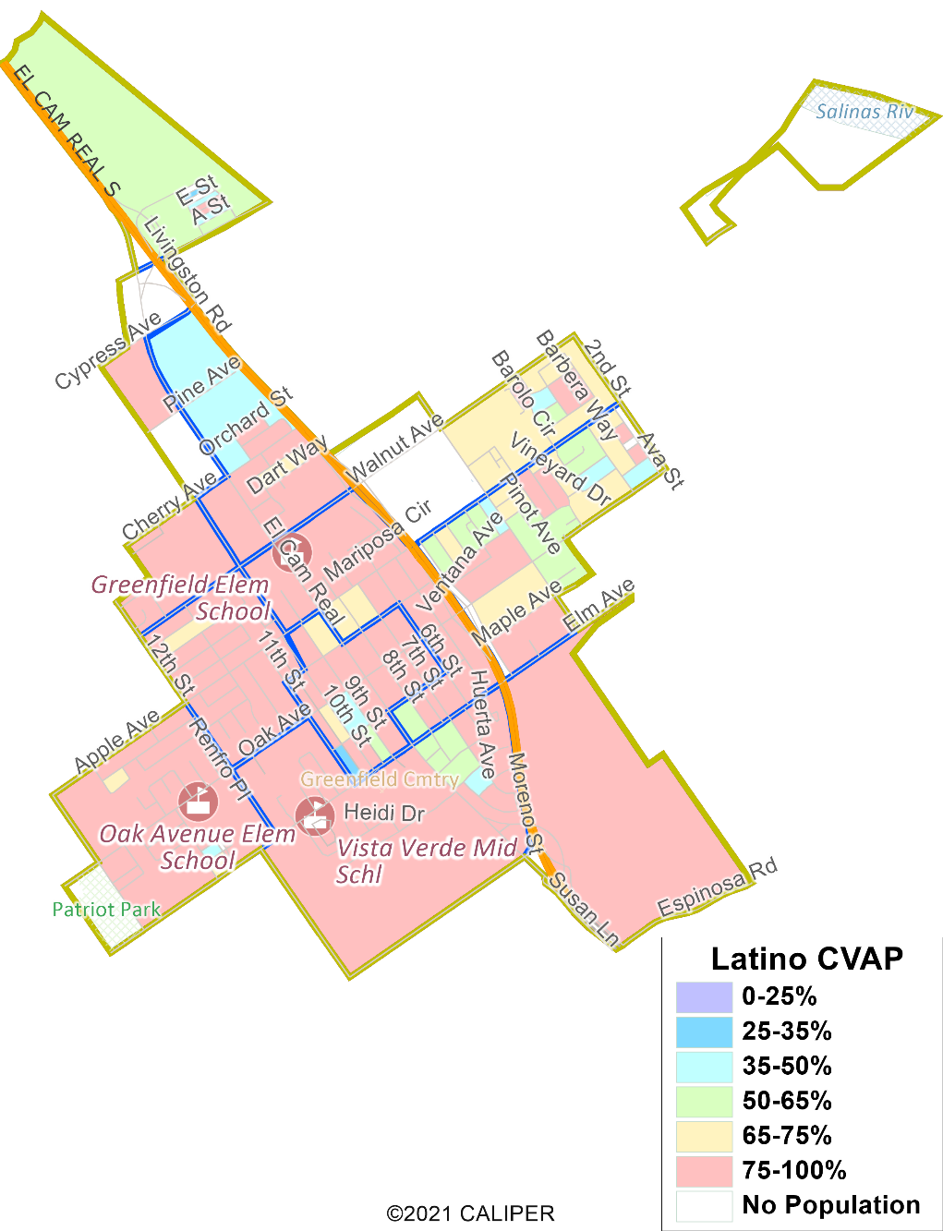
Latino CVAP
Latinos are heavily concentrated throughout the city, especially west of Highway 101.
There are no significant concentrations of other protected classes.

Slide 10

Defining Neighborhoods
1st Question: what is your neighborhood?
2nd Question: what are its geographic boundaries?
Examples of physical features defining a neighborhood boundary:
Natural neighborhood dividing lines, such as highway or major roads, rivers, canals and/or hills
Areas around parks or schools
Other neighborhood landmarks
In the absence of public testimony, planning records and other similar documents may provide definition.

Slide 11
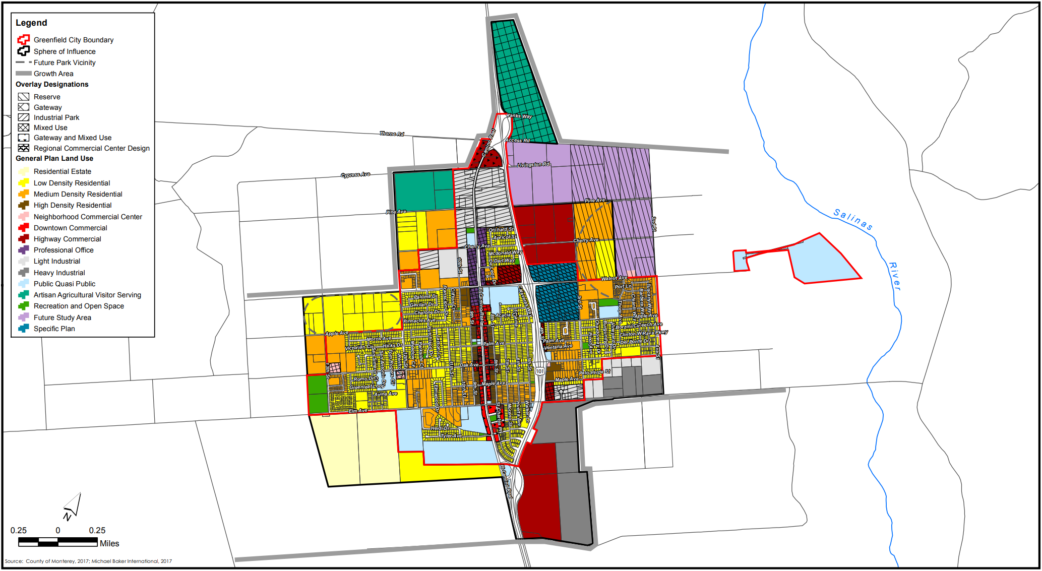
Defining Neighborhoods

Slide 12
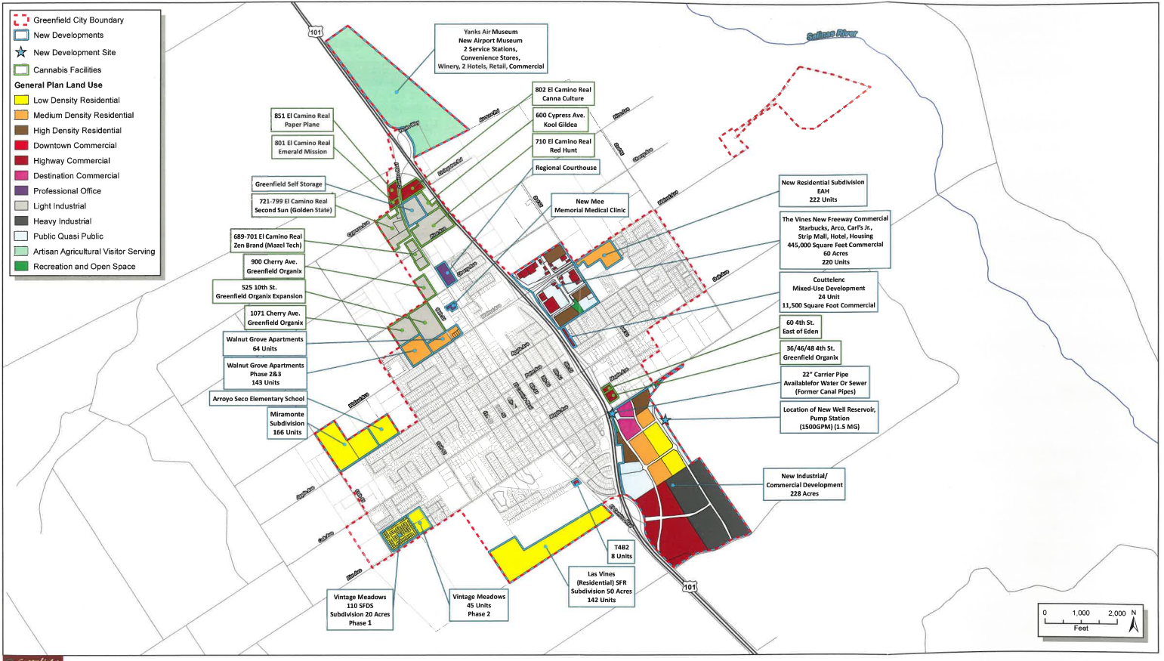
Defining Neighborhoods

Slide 13
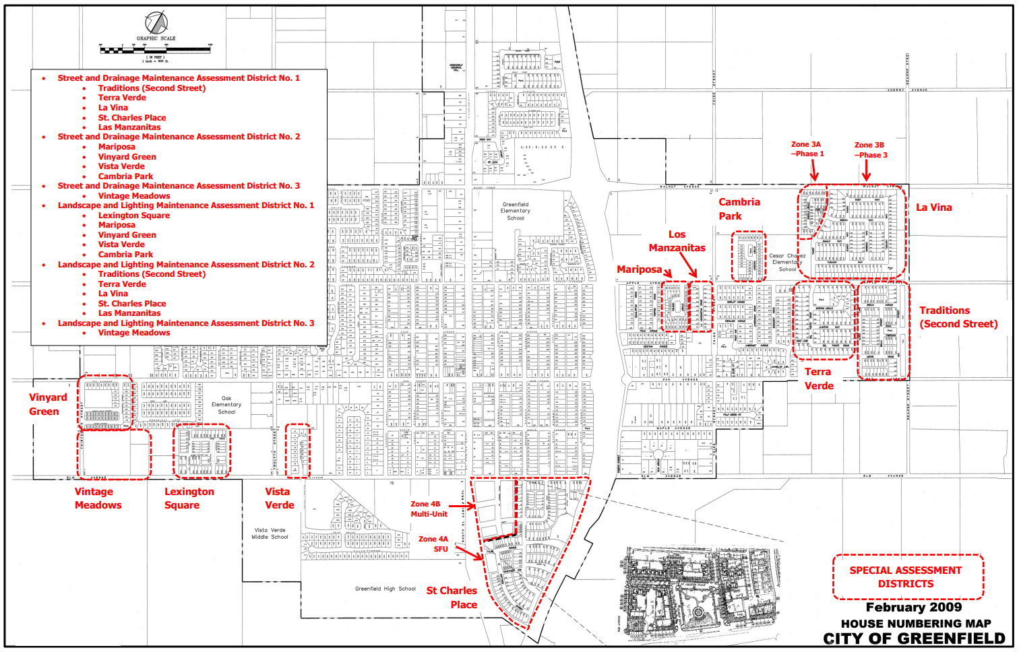
Defining Neighborhoods

Slide 14
Beyond Neighborhoods: Defining Communities of Interest
1st Question: What defines your community?
Geographic Area, plus
Shared issue or characteristic
Shared social or economic interest
Impacted by city policies
Tell us “your community’s story”
2nd Question:
Would this community benefit from being “included within a single district for purposes of its effective and fair representation”?
Or would it benefit more from having multiple representatives?
Definitions of Communities of Interest may not include relationships with political parties, incumbents, or political candidates.

Slide 15
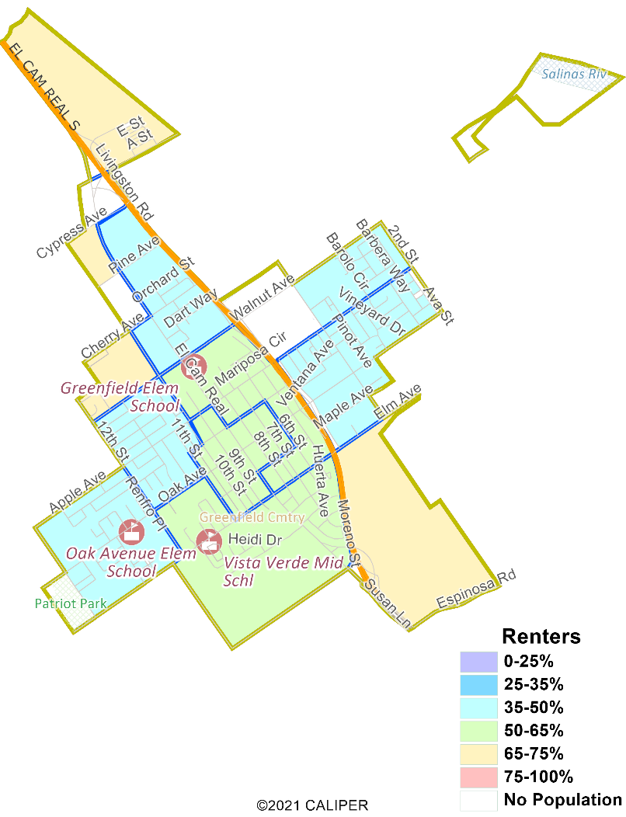
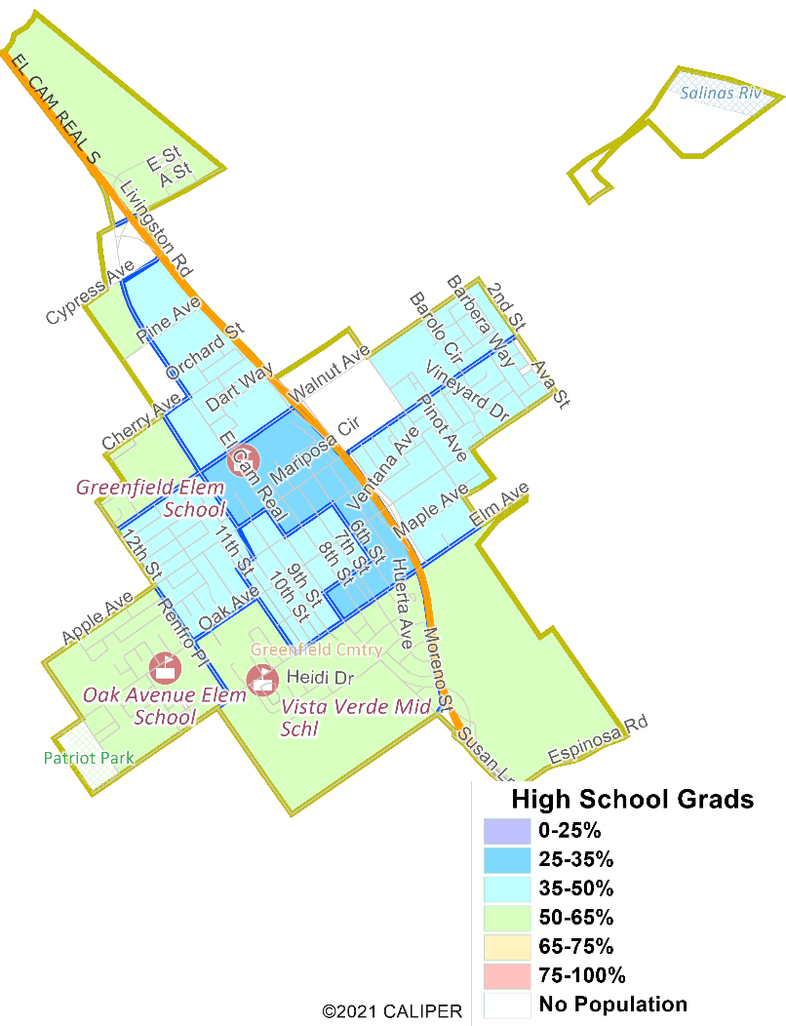
Socio-Economic Demographics
Renters are found throughout the city, while those without a high school degree are concentrated in the center.

Slide 16
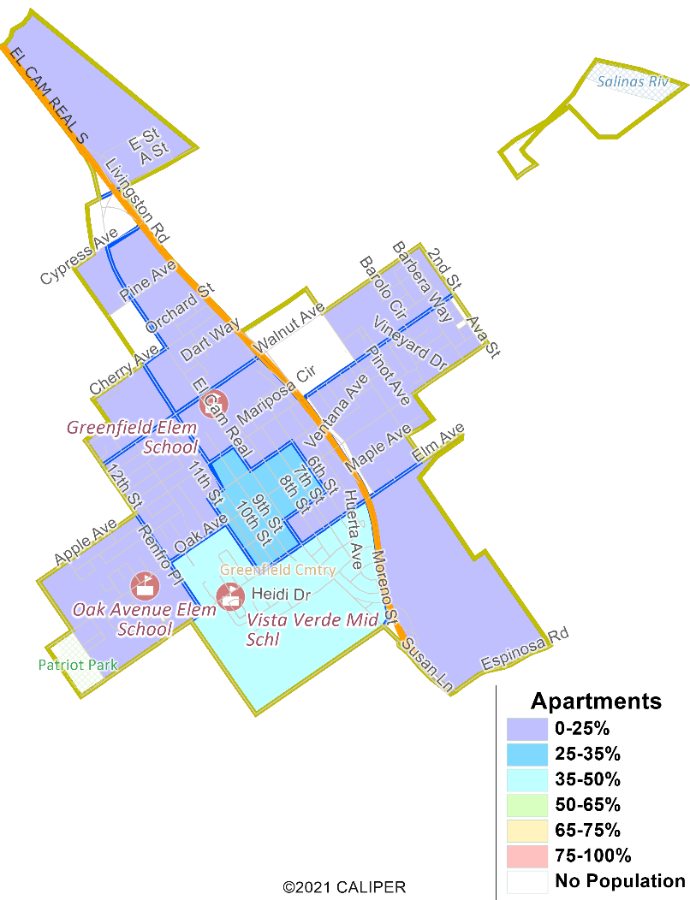
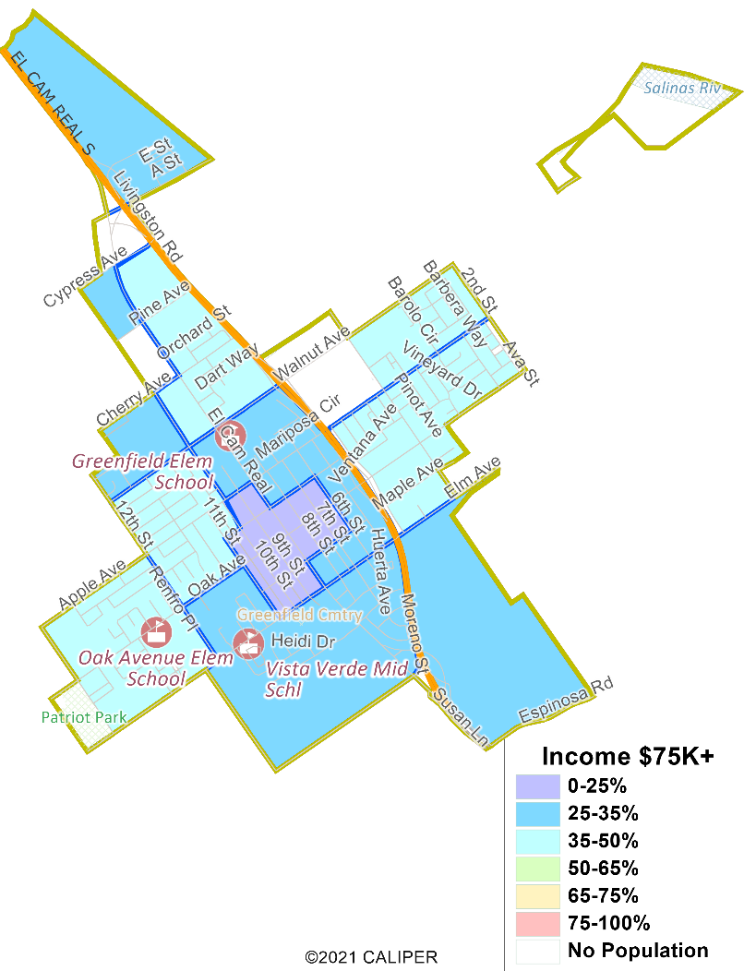
Socio-Economic Demographics
There are slightly more apartment dwellers toward the south, and slightly more high earners toward the west and east.

Slide 17
Mapping Tools
Different tools for different purposes
Different tools for different levels of comfort and interest
Simple “review draft maps” tool (included)
Easy-to-use “Draw your neighborhood” tool (available)
Paper- and Excel-based simple “Draw a draft map” tools (available)

Slide 18
Public Hearing & Discussion
Would the downtown area be better represented by multiple councilmembers, or should it be kept together in one district?
Would the freeway be considered a natural boundary between different districts?
Would you like respecting voters’ choices / continuity of office to be a consideration when drawing boundaries?
Would you like future growth to be a consideration, and if so, are there any large housing developments that are coming in the near future?
Which mapping tools, if any, would you like to make available to the public?
Are you ready to decide on four or five districts, and if not, would you like to see plans with a version for each?

